Slide 1
Drupal 8 Installing Commerce Kickstart on Acquia Dev Desktop (MAC)
On Acquia Dev Desktop
With an already Existing Acquia Dev Desktop

Slide 2
What Is Commerce Kickstart?
Commerce Kickstart is the quickest way to get up and running with Drupal Commerce. It includes the latest versions of Drupal core, Drupal Commerce, and the other modules it depends on. It also gives you a set of options to create a fully-featured demo store out of the box complete with an attractive theme, catalog and search configuration, and a custom back office interface.
Who should use Commerce Kickstart? Anyone who wants to skip weeks of configuration to build a commerce site on the Drupal Commerce framework.
Sponsored by Commerce Guys.

Slide 3
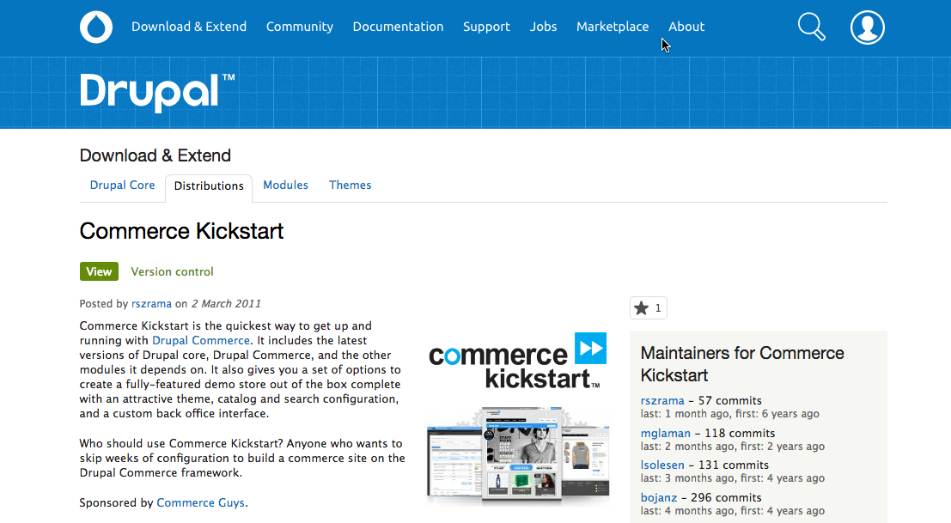
https://www.drupal.org/project/commerce_kickstart

Slide 4
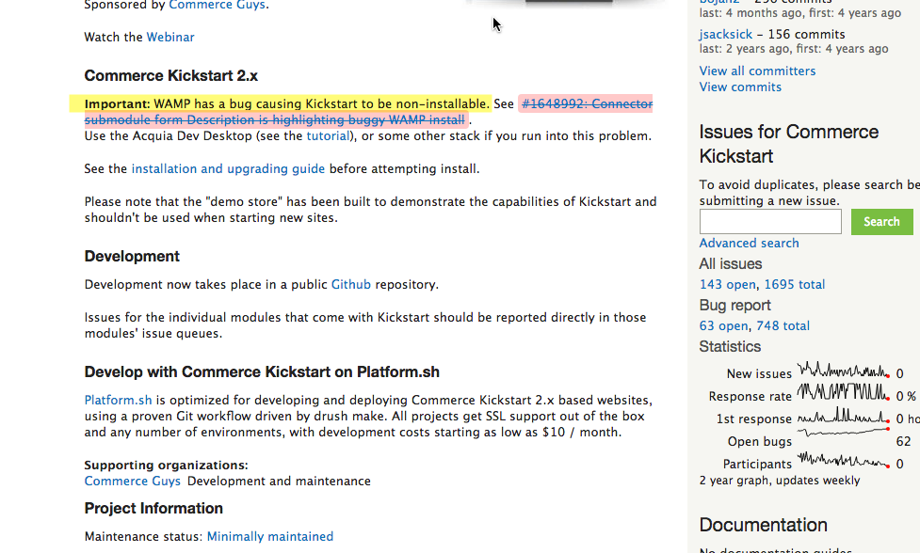
Please do not try to install Commerce Kickstart on WAMP

Slide 5
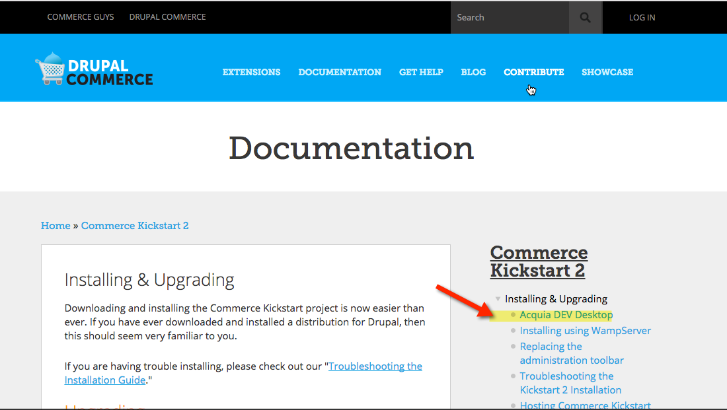
Installing & Upgrading Guide https://drupalcommerce.org/commerce-kickstart-2/install

Slide 6
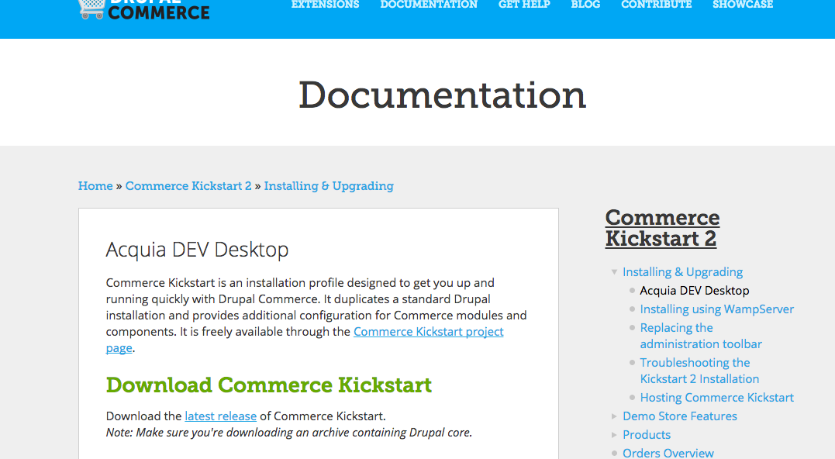
https://drupalcommerce.org/commerce-kickstart-2/acquia-dev-desktop A good step-b-step set of instructions, but the screen shots are out of date

Slide 7
Steps to Establish Commerce Kickstart on a Computer with Acqaui Dev Desktop Already Installed
Start Acquia Dev desktop
Close the Welcome window
Select + button to build a new Drupal 8 Site
Scroll down and select the Commerce Kickstart install
Follow the instructions
After the site is installed, enable Commerce Kickstart and Alpha core and make Commerce Kickstart the Default theme

Slide 8
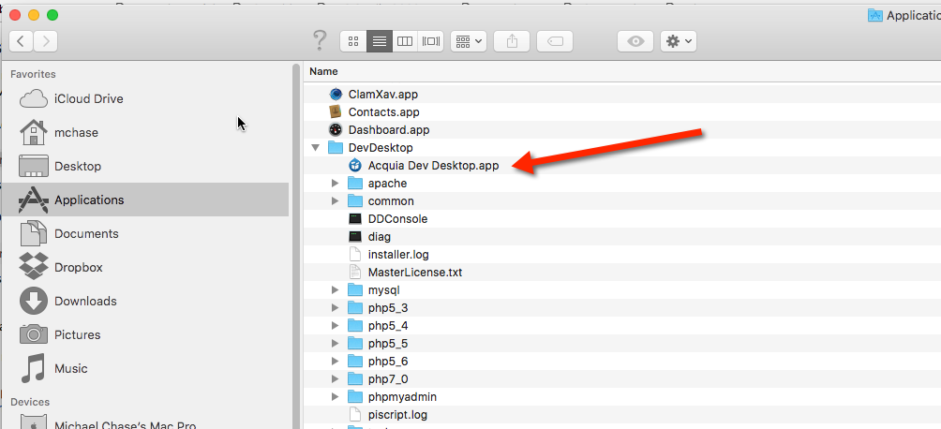
Start the Acquia Dev Desktop App

Slide 9
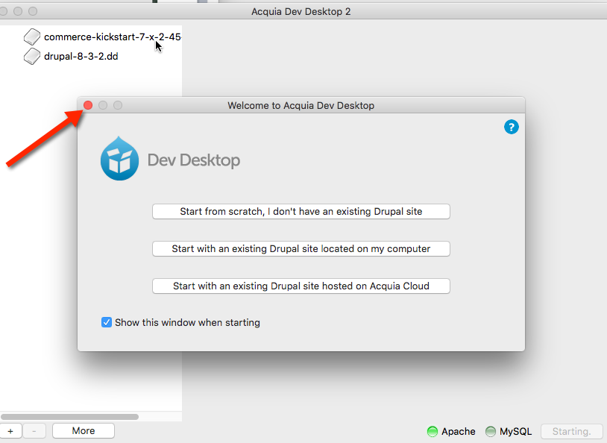
Close the Welcome Window

Slide 10
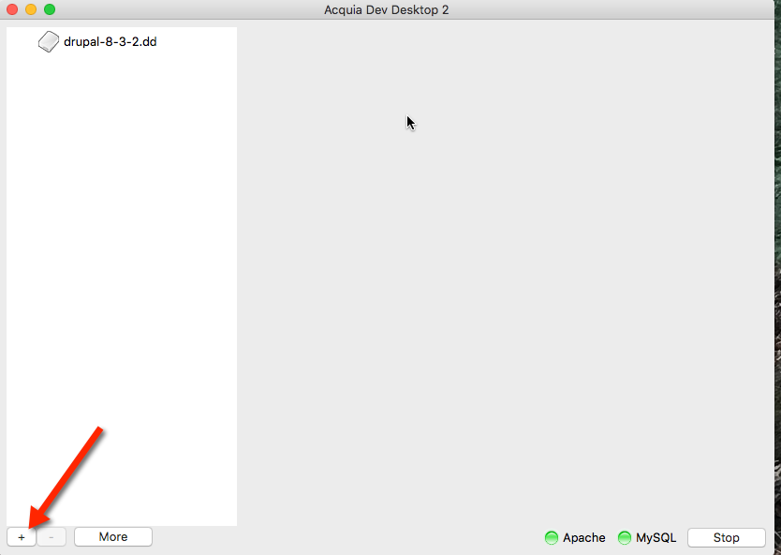
Select the + button to add a new Drupal 8 site

Slide 11
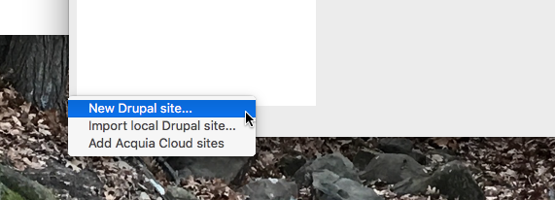
Select “New Drupal site…”

Slide 12
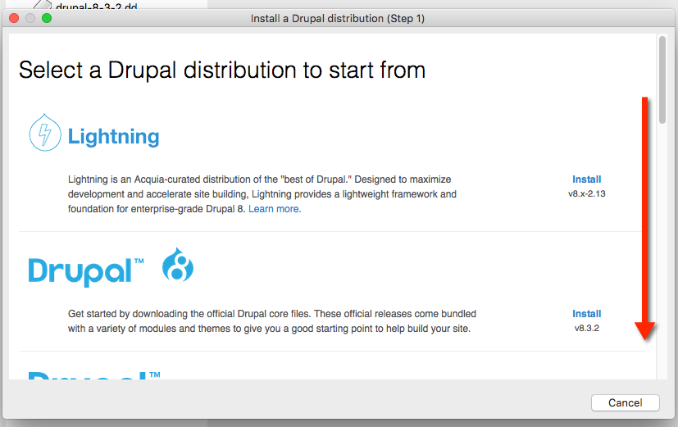
Scroll down and find Commerce Kickstart

Slide 13
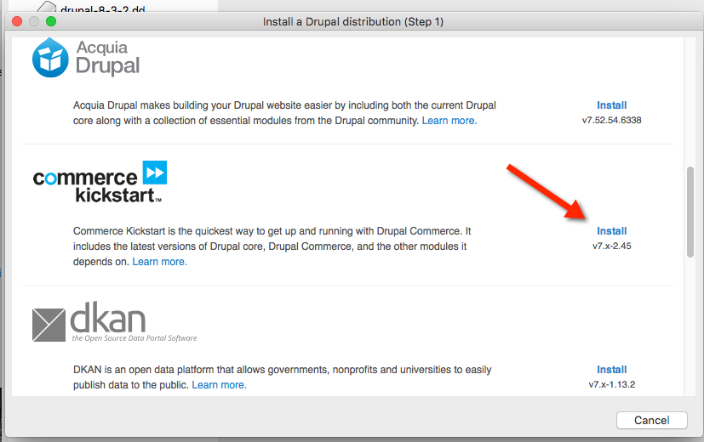
Select Commerce Kickstart Install

Slide 14
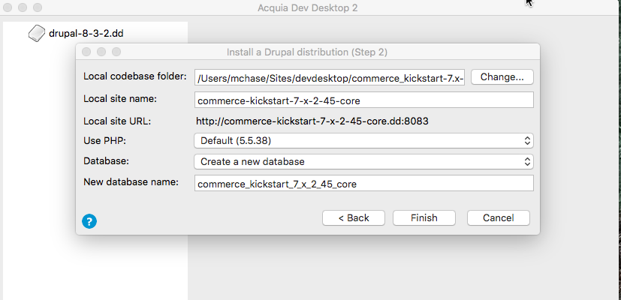
Select Finish

Slide 15
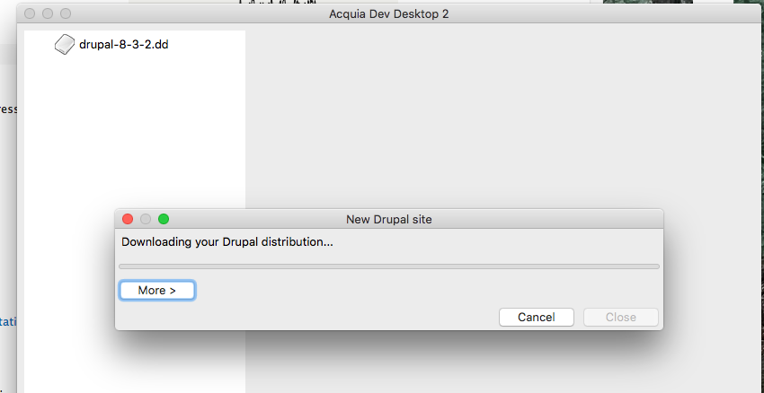
Be Patient, this install takes a while

Slide 16
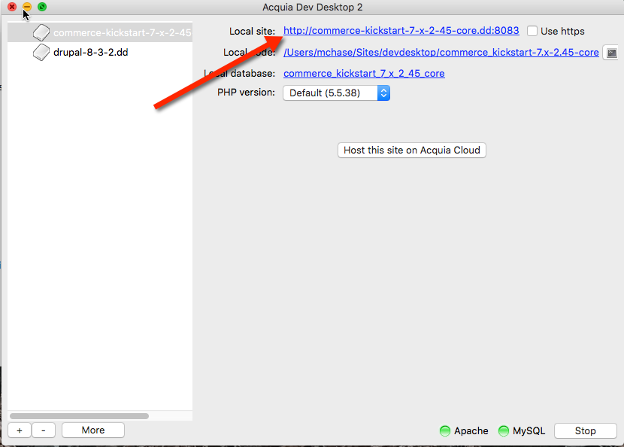
Select the CMS URL to being the process

Slide 17
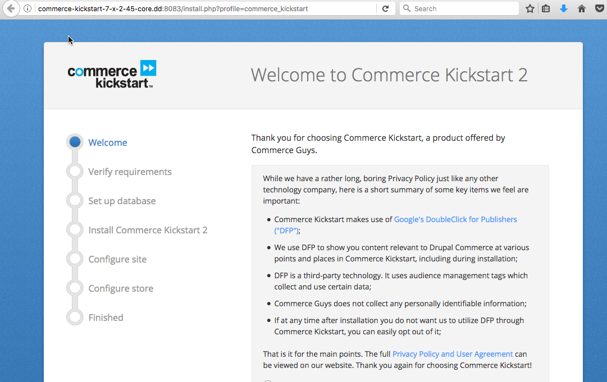
Read the Privacy Policy & Scroll down

Slide 18
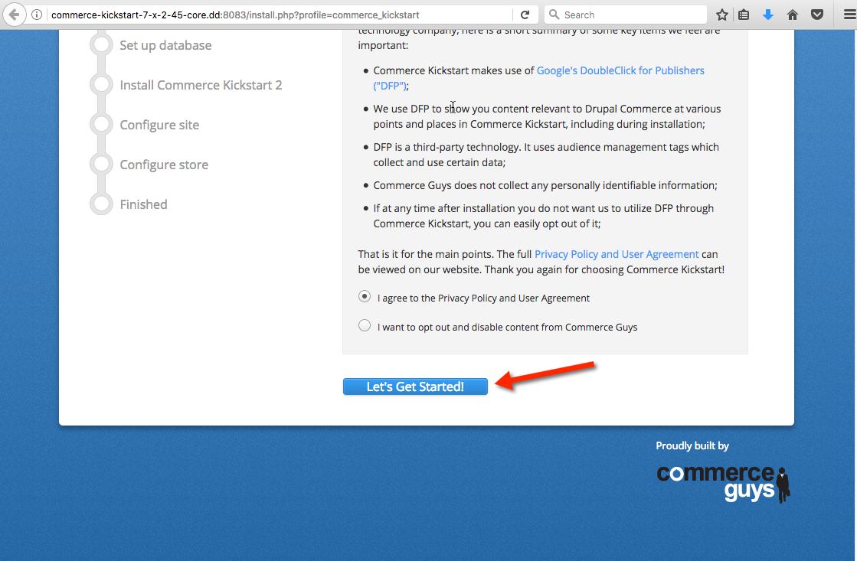
Select “Let’s Get Started”

Slide 19
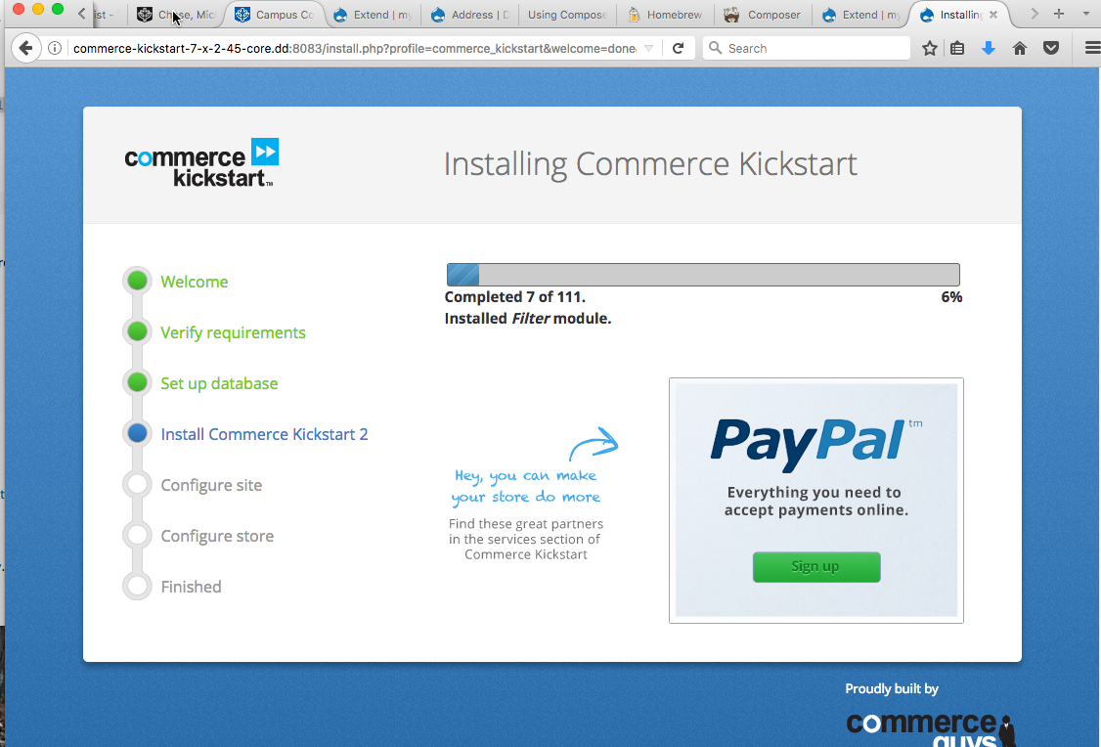
Be Patient, this takes a while

Slide 20
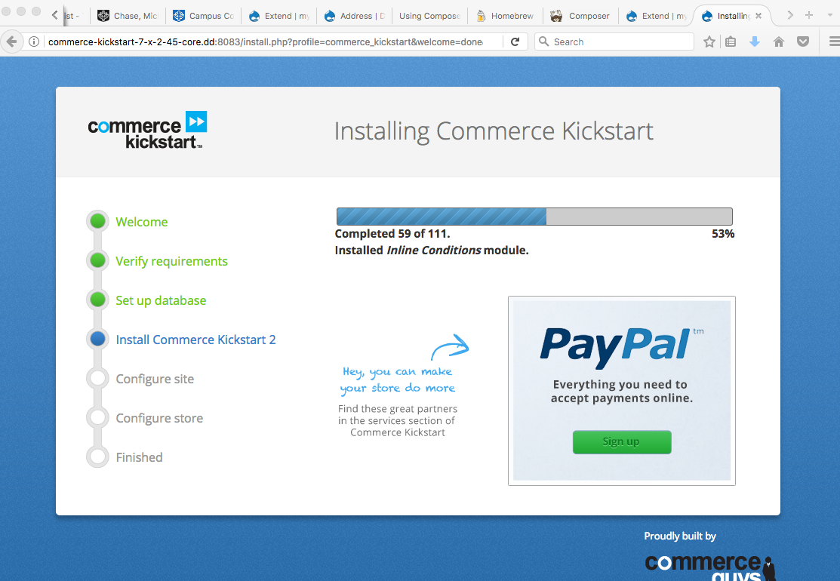

Slide 21
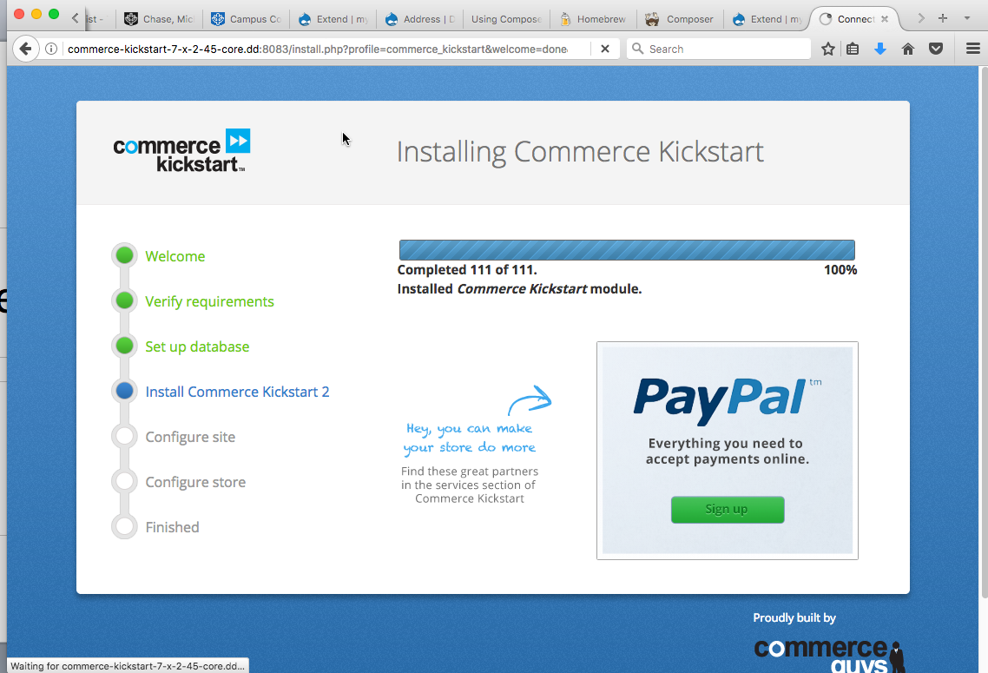

Slide 22
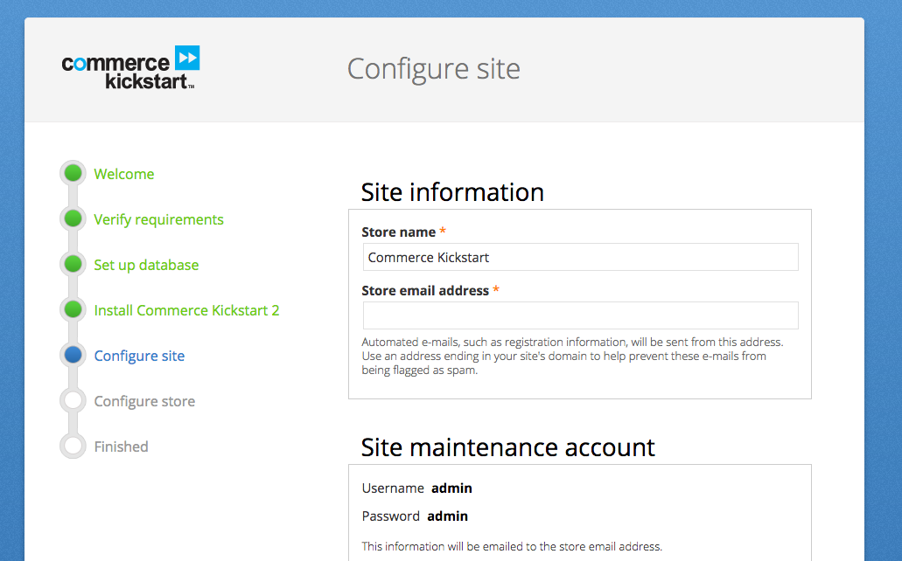
Configure Site – Store Information

Slide 23
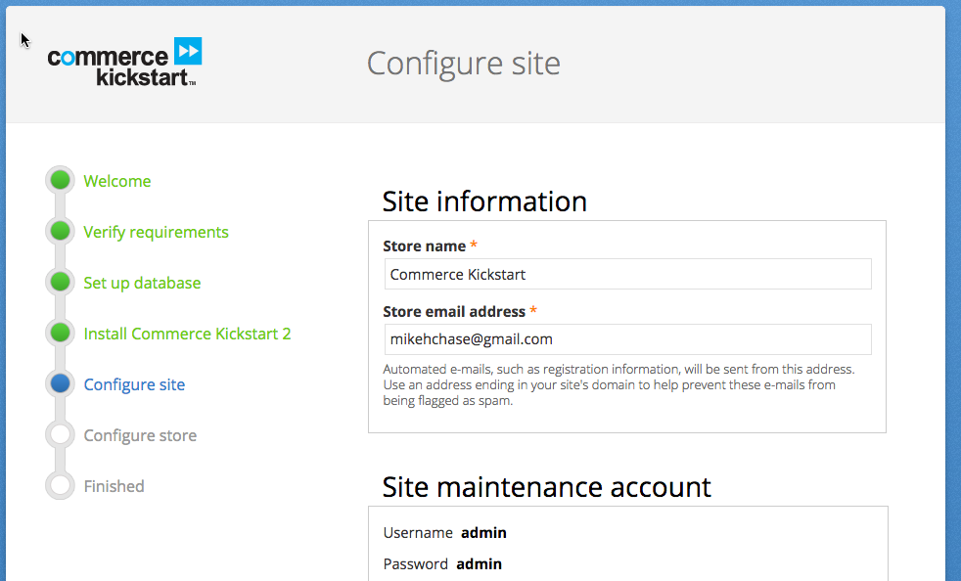
Configure Site - Site Information

Slide 24
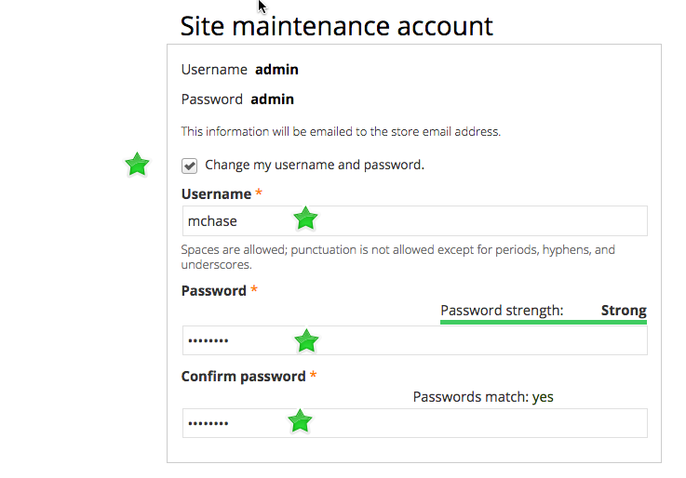
Change the name & password from admin/admin

Slide 25
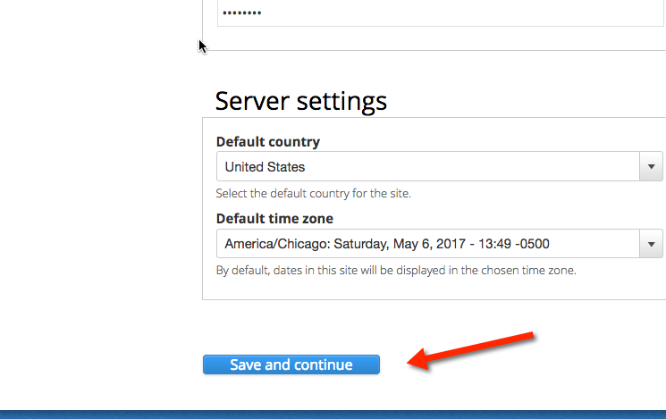
Set Country and Time zone and Save

Slide 26
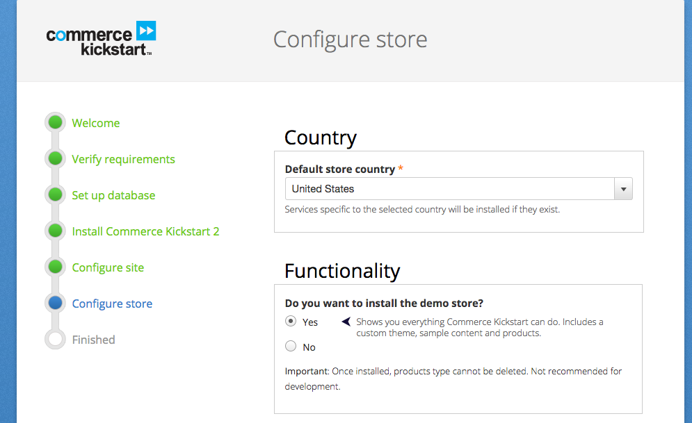
Installing the Demo Store

Slide 27
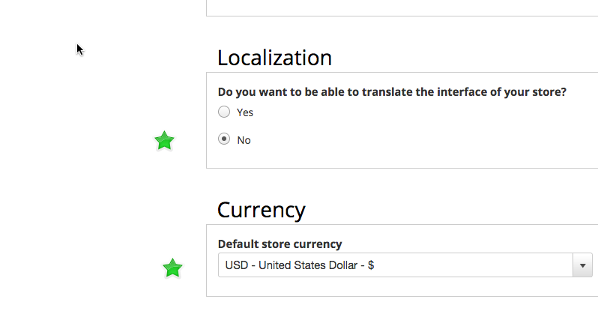
I’m not interested in Translation for this test store

Slide 28
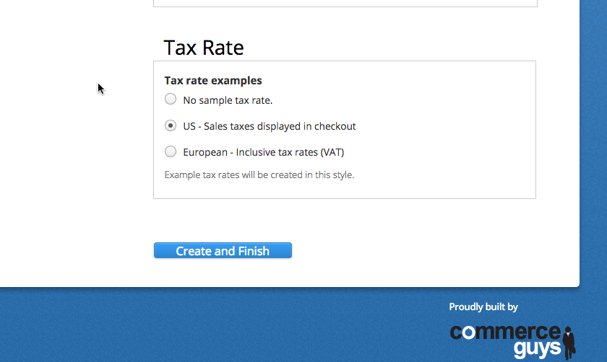
I enabled US – Sales taxes displayed in checkout

Slide 29
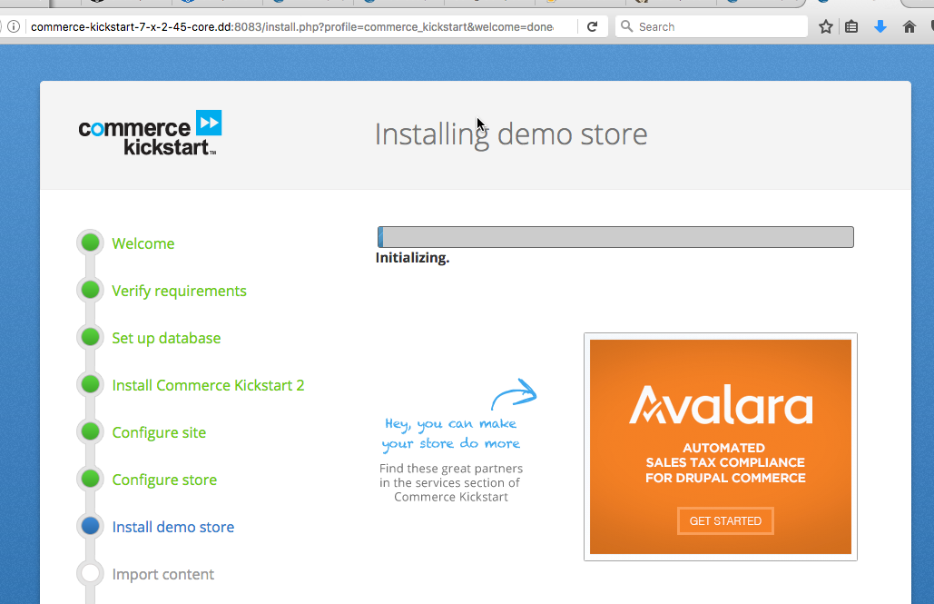

Slide 30
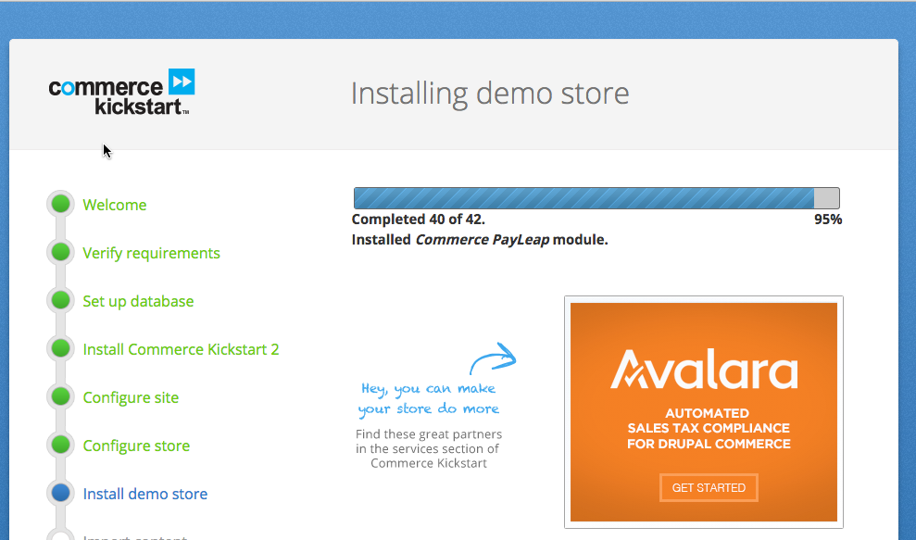

Slide 31
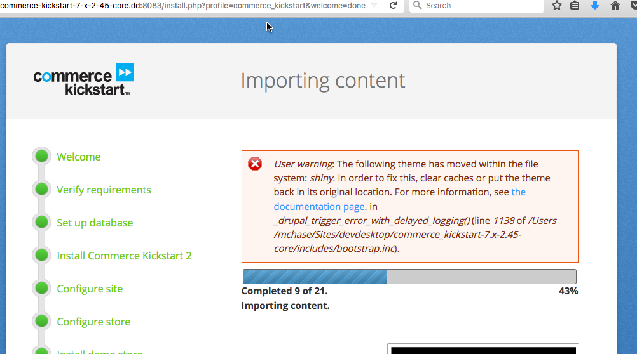

Slide 32
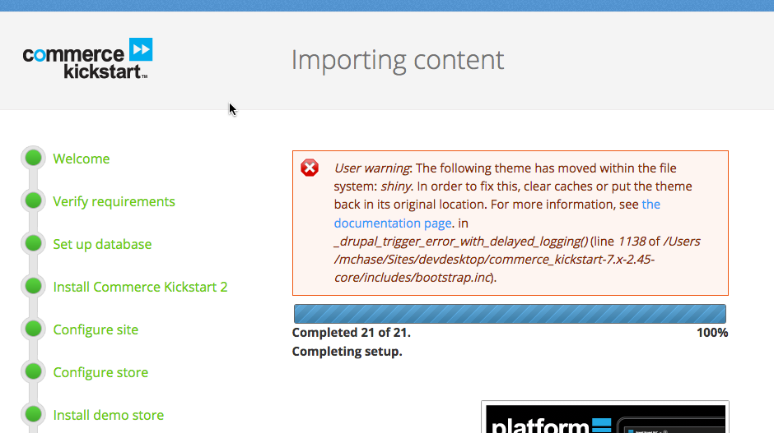

Slide 33
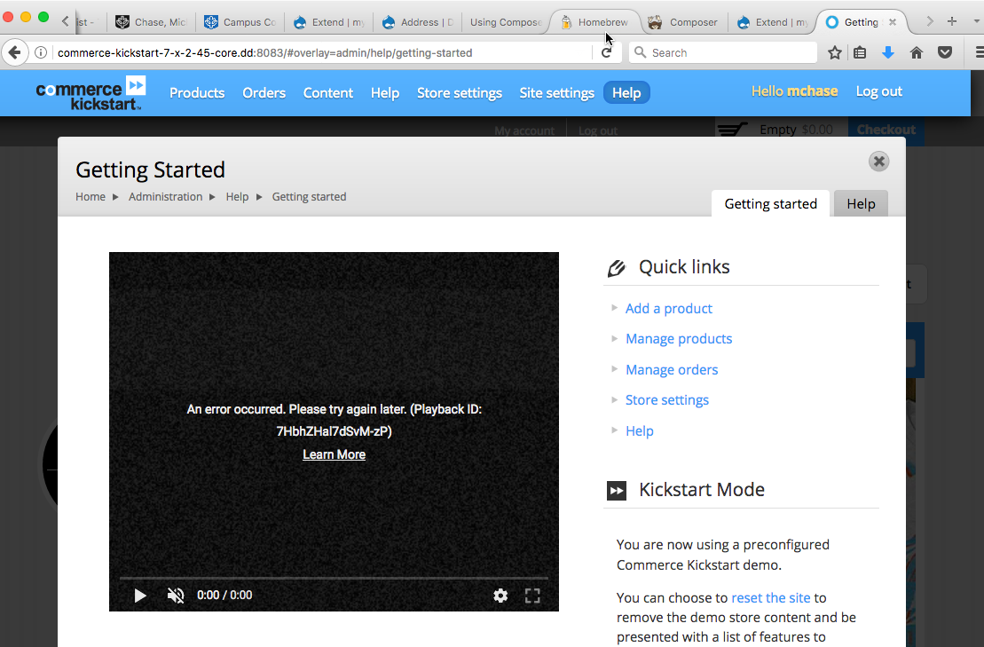
The site is established, Solve Theme issue

Slide 34
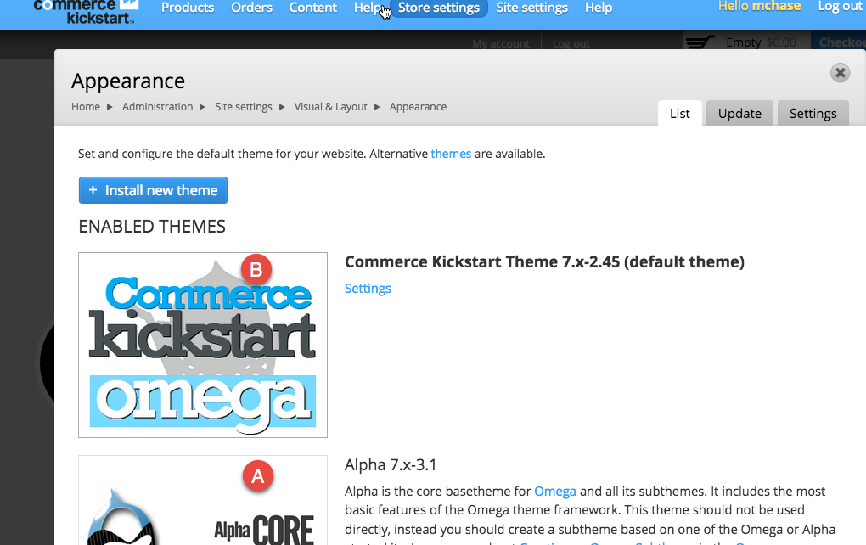
Enable Alpha Core & Commerce Kickstart Omega (As Default)

Slide 35
Select and Run the Commerce Kickstart Drupal 8 Web App

Slide 36
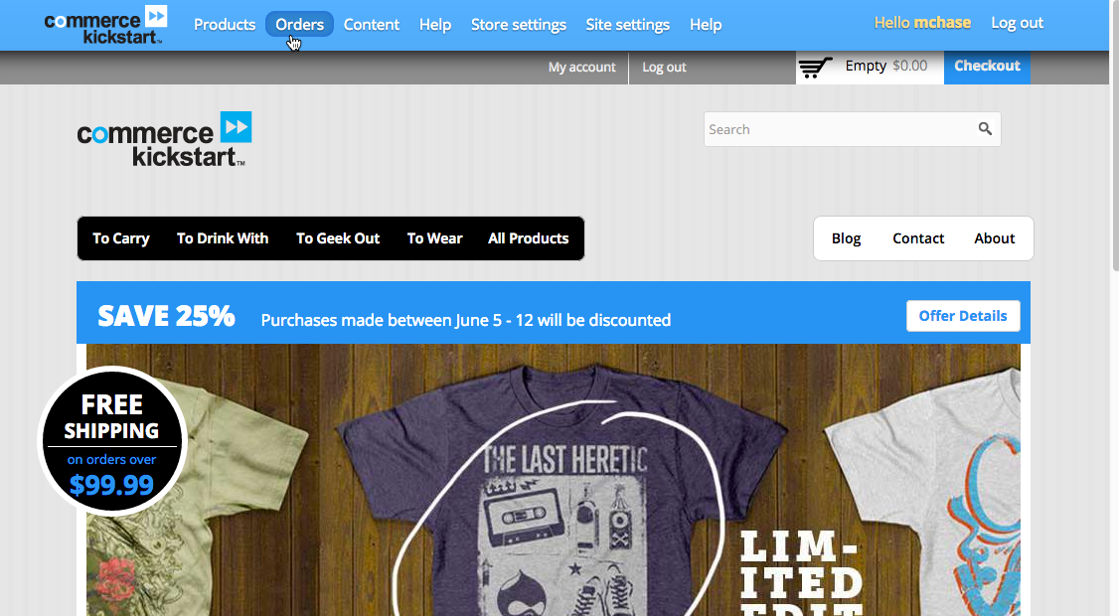
Site Is Ready To Use

Slide 37
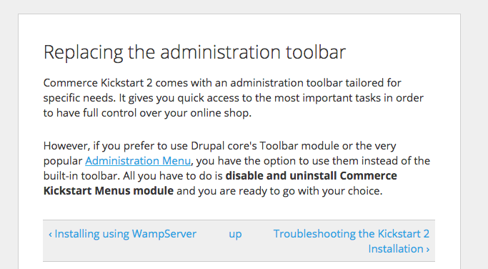
Replacing the Admin toolbar

